Slide 1
OJT REVIEW
(8th Aug-11th Sep)
Gitesh Lalit
YM109

Slide 2
Key Highlights
01
Understanding Concepts
02
Hands-On
03
Doubts Session
04
Assessment Tests
Key Highlights
05
Logic Building Exercises
06
Projects
07
Add-On Sessions

Slide 3
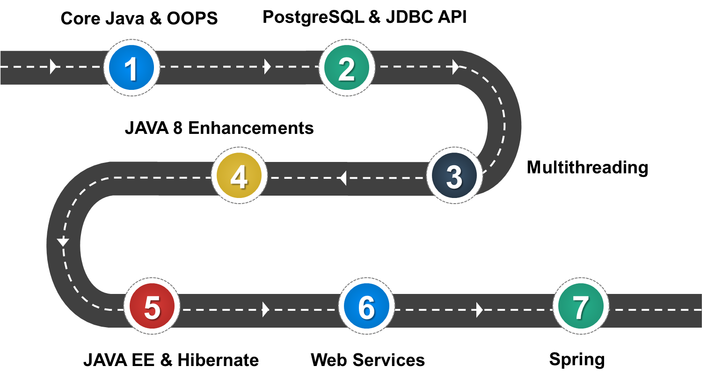
External Training Roadmap

Slide 4
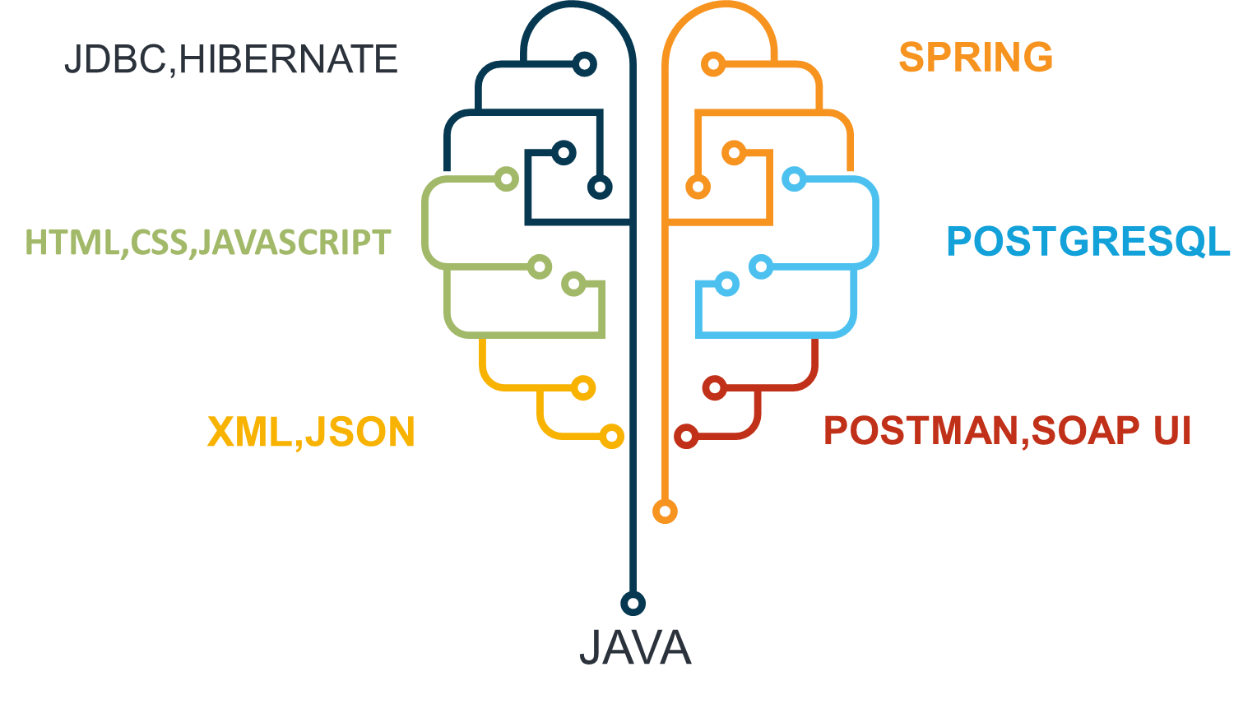
Technologies

Slide 5
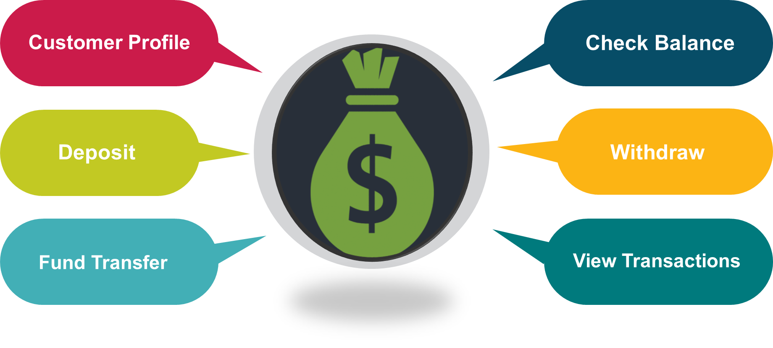
Banking Application

Slide 6
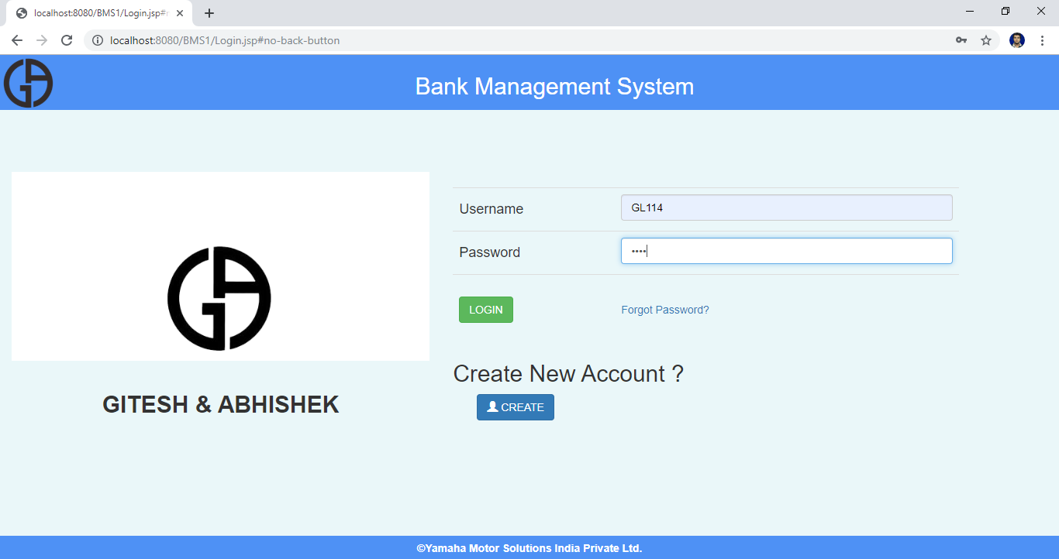
Output Screens
BMS Login Page

Slide 7
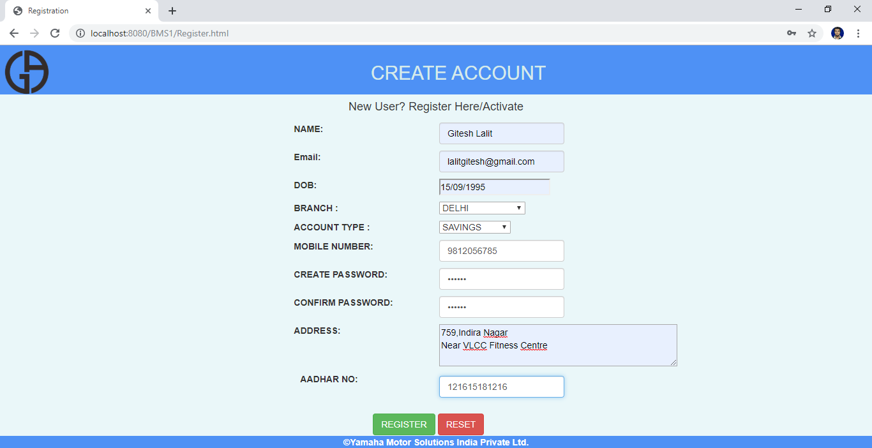
Create New Account

Slide 8
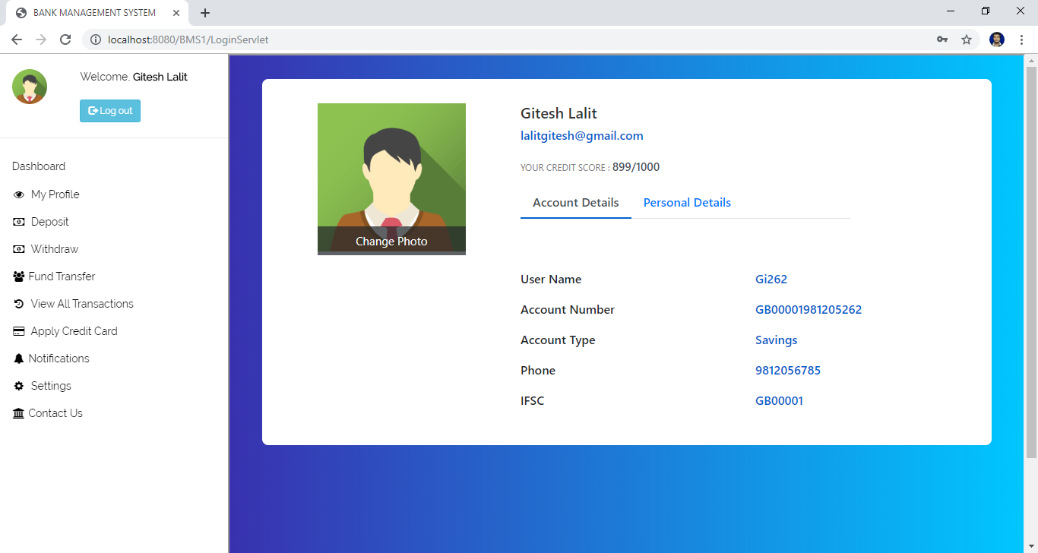
Dashboard

Slide 9
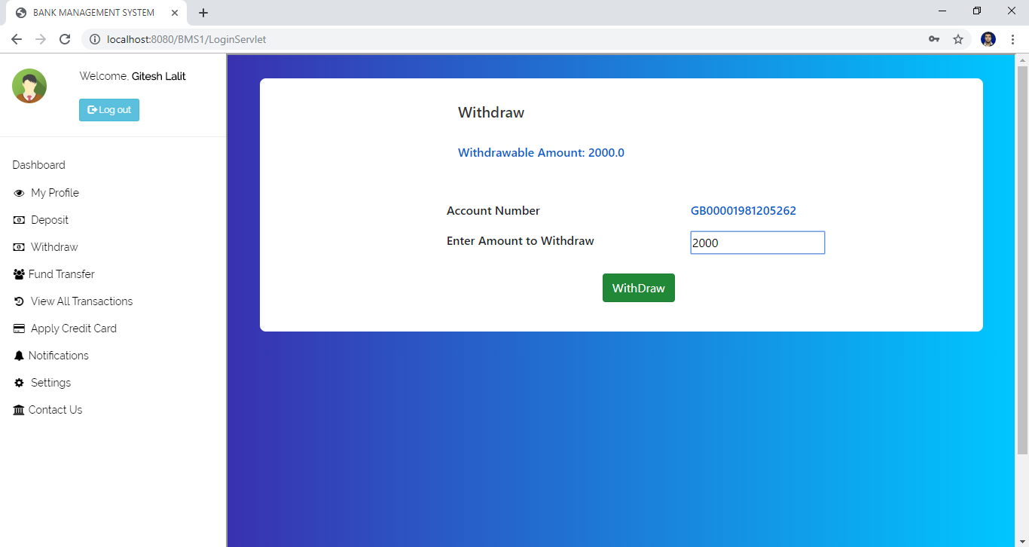
Money Withdrawal Screen

Slide 10
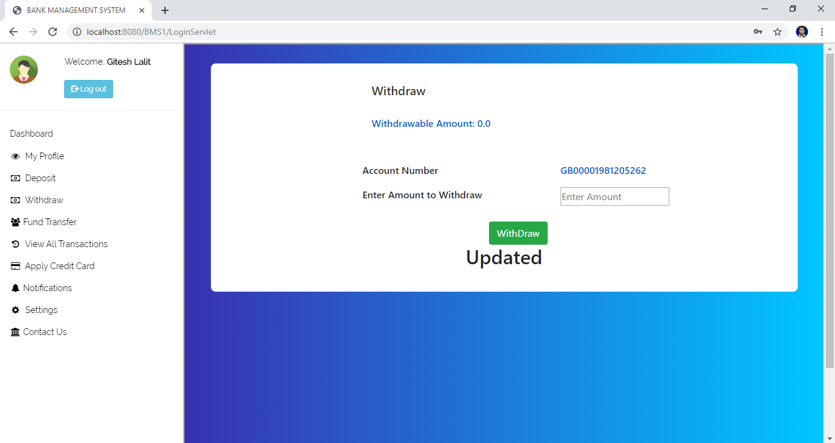
Dynamically Updated Balance

Slide 11
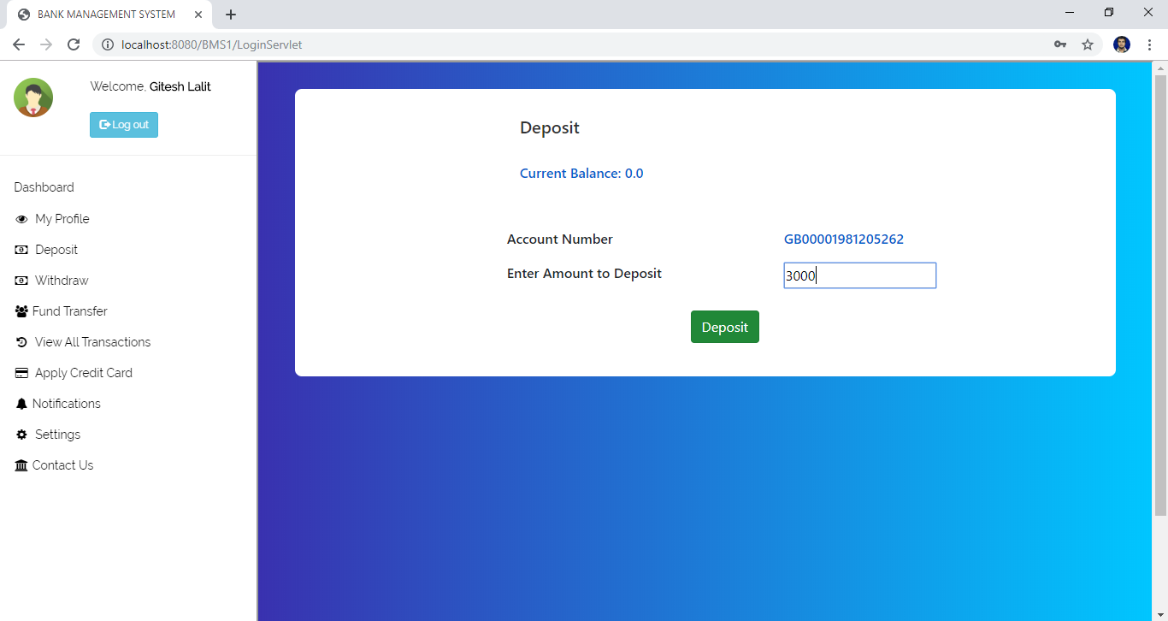
Money Deposit Screen

Slide 12
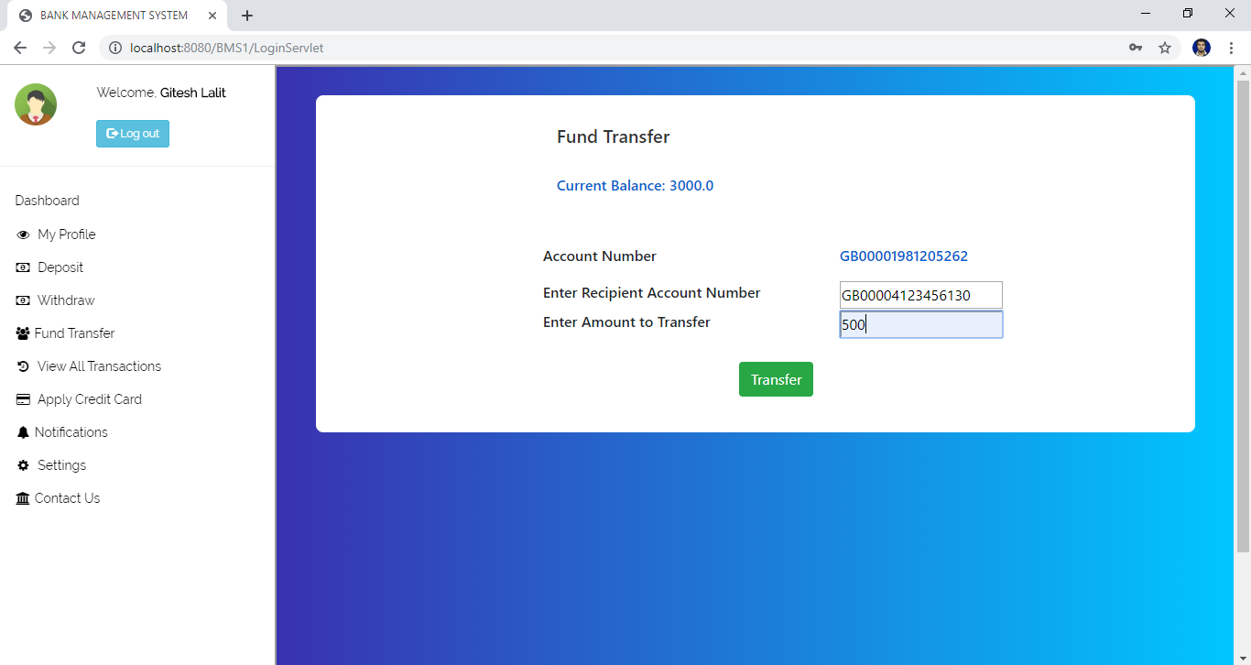
Fund Transfer

Slide 13
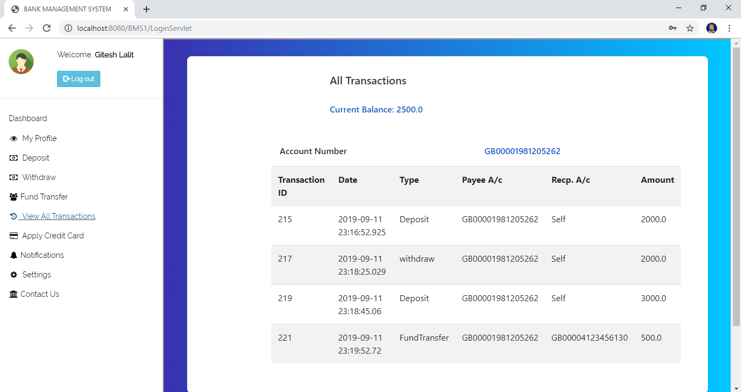
All Transactions

Slide 14



Challenges
Learning new concepts and technologies in short span of time
Understanding ways to solve a problem with different end-users
Developing banking application project using various technologies

Slide 15
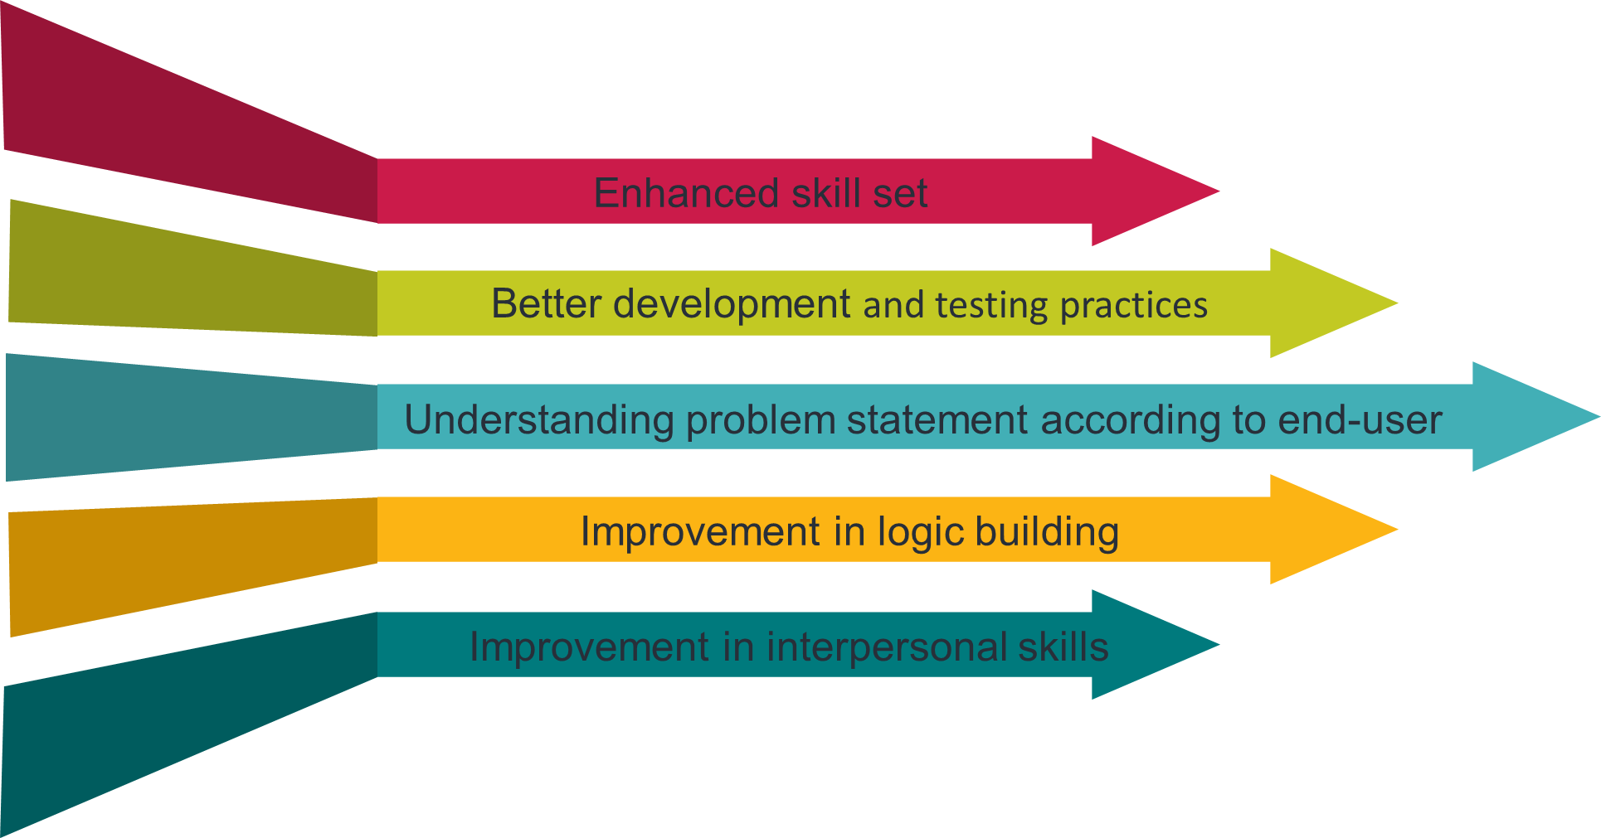
Improvements

Slide 16

Copyright© YAMAHA MOTOR SOLUTIONS CO., LTD.

